Slide 1


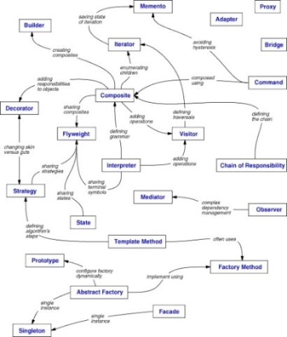
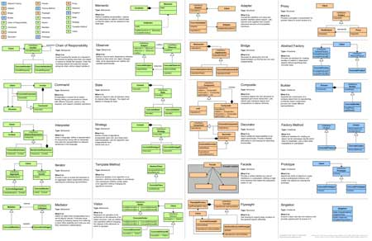
Design Patterns Introduction
General and reusable solutions to common problems in software design
SoftUni Team
Technical Trainers
http://softuni.bg
Software University

Slide 2

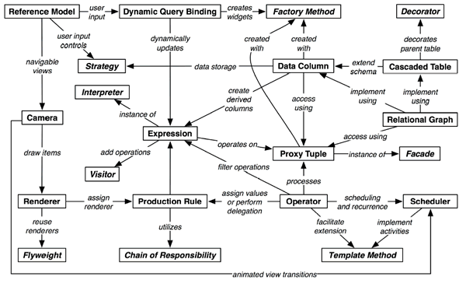
Table of Contents
What is a Design Pattern?
Why Design Patterns?
Types of Design Patterns
Creational patterns

Slide 3



What is a Design Pattern?
Name, Problem, Solution and Consequences

Slide 4
What Design Patterns Are?
General and reusable solutions to common problems in software design
Problem/solution pairs within a given context
Not a finished solution
A template or recipe for solving certain problems
With names to identify and talk about them

Slide 5
What Design Patterns Are? (2)
Patterns deal with
Application and system design
Abstractions on top of code
Relationships between classes or other collaborators
Problems that have already been solved
Patterns are not concerned with
Algorithms
Specific implementation classes

Slide 6

Origins of Design Patterns
Christopher Alexander
Very successful architect
A Pattern Language: Towns, Buildings, Construction, 1977
Context:
City Planning and Building architectures
"Each pattern describes a problem which occurs over and over again in our environment and then describes the core of the solution to that problem, in such a way that you can use this solution a million times over, without ever doing it in the same way twice".

Slide 7

Origins of Design Patterns (2)
Search for recurring successful designs
Emergent designs from practice
Supporting higher levels of design reuse is quite challenging
Described in Gama, Helm, Johnson, Vlissides 1995 (i.e., "Gang of Four Book")
Based on work by Christopher Alexander
An Architect on building homes, buildings and towns

Slide 8
Describing Design Patterns
Graphical notation is generally not sufficient
In order to reuse design decisions the alternatives and trade-offs that led to the decisions are critical knowledge
Concrete examples are also important
The history of the why, when, and how set the stage for the context of usage
Collaborations
Structure
Pattern name
Motivation
Participants
Known Uses
Applicability
Intent
Also Known As
Consequences
Implementation
Sample Code
Related Patterns

Slide 9
Elements of Design Patterns
Design patterns have four essential elements:
Pattern Name
Increases vocabulary of designers
Problem
Intent, context, when to apply
Solution
UML-like structure, abstract code
Consequences
Results and tradeoffs

Slide 10
Pattern Name
Used to describe:
A design problem
Its solutions
Its consequences
Increases design vocabulary
Design at a higher level of abstraction
Enhances communication
"The hardest part of programming is coming up with good variable names"

Slide 11

Problem
Describes when to apply the pattern
Explains the problem and its context
May describe specific design problems and/or object structures
May contain a list of preconditions that must be met before it makes sense to apply the pattern

Slide 12

Solution
Describes the elements that make up the
Design
Relationships
Responsibilities
Collaborations
Does not describe specific concrete implementation
Abstract description of design problems and how the pattern solves it

Slide 13

Consequences
Results and trade-offs of applying the pattern
Critical for:
Evaluating design alternatives
Understanding costs
Understanding benefits
Includes the impacts of a pattern on a system’s:
Flexibility, Extensibility, Portability

Slide 14

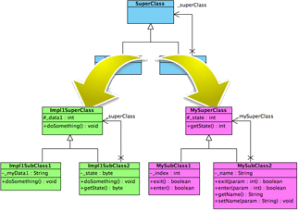
Why Design Patterns?

Slide 15
Benefits of Design Patterns
Design patterns enable large-scale reuse of software architectures
Help document how systems work
Patterns explicitly capture expert knowledge and design trade-offs
Patterns help improve developer communication (shared language)
Pattern names form a common vocabulary
Patterns help ease the transition to OO technology

Slide 16
When to Use Patterns?
Solutions to problems that recur with variations
No need for reuse if problem only arises in one context
Solutions that require several steps:
Not all problems need all steps
Patterns can be overkill if solution is a simple linear set of instructions!
Do not use patterns when not required
Overdesign is evil!

Slide 17
Drawbacks of Design Patterns
Patterns do not lead to a direct code reuse
Patterns are deceptively simple
Teams may suffer from pattern overload
Patterns are validated by experience and discussion rather than by automated testing
Integrating patterns into the software development process is a human-intensive activity
Use patterns if you understand them well

Slide 18
Criticism of Design Patterns
Targets the wrong problem
The design patterns may just be a sign of some missing features of a given programming language
Lacks formal foundations
The study of design patterns has been excessively ad-hoc
Leads to inefficient solutions
Does not differ significantly from other abstractions

Slide 19
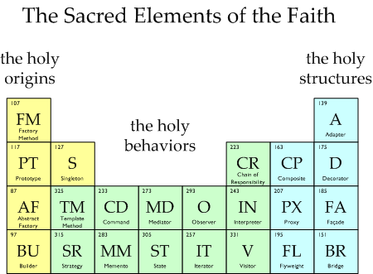
Types of Design Patterns

Slide 20
Three Main Types of Patterns
Creational patterns
Deal with initializing and configuring classes and objects
Structural patterns
Describe ways to assemble objects to implement a new functionality
Composition of classes or objects
Behavioral patterns
Deal with dynamic interactions among societies of classes and objects
How they distribute responsibility

Slide 21
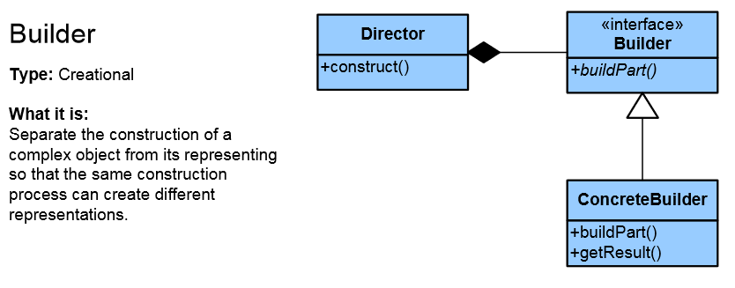
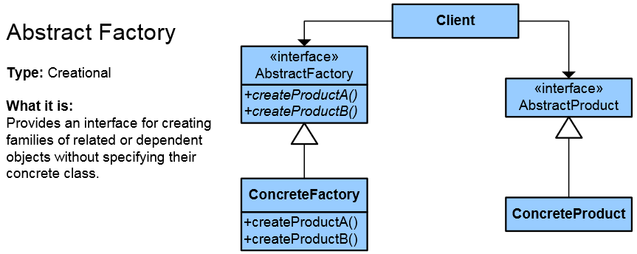
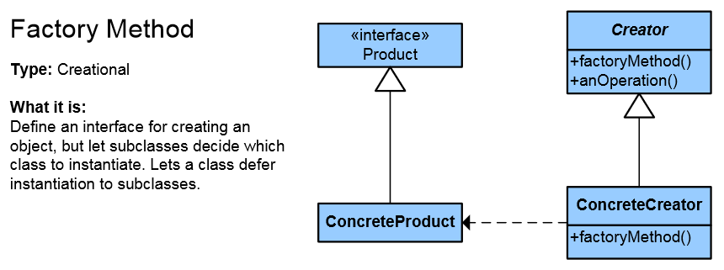
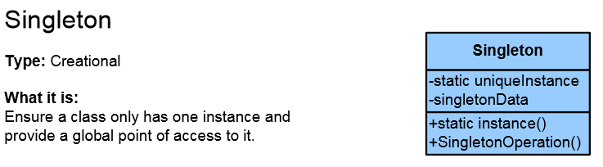
Creational Patterns

Slide 22
Creational Patterns
Deal with object creation mechanisms
Trying to create objects in a manner suitable to the situation
Composed of two dominant ideas
Encapsulating knowledge about which concrete classes the system uses
Hiding how instances of these concrete classes are created and combined

Slide 23
Singleton
The Singleton class is a class that is supposed to have only one (single) instance
Sometimes Singleton is wrongly thought of as a global variable – it is not!
Possible problems:
Lazy loading
Thread-safe

Slide 24
Simple Factory
This is not a Pattern
Often mistaken with the Factory Pattern
It is used quite often
This is the preparation for the real Pattern
Export the object creation in one place
If we making changes, we make them in one place
We can hide complex object creation
Higher level of abstraction

Slide 25
Factory Method
Objects are created by separate method
Produces objects as normal Factory
This allows achieving higher reusability and flexibility in the changing applications

Slide 26
Abstract Factory
Abstraction in object creation
Create a family of related objects
The Abstract Factory Pattern defines interface for creating sets of linked objects
Without knowing their concrete classes
Used in systems that are frequently changed
Provides flexible mechanism for replacement of different sets
Notes:
Множество – йерархия, библиотека от класове, някаква съвкупност от свързани, зависими обекти
Множеството може ли да е само един обект?

Slide 27
The Builder Pattern
Separates the construction of a complex object from its representation so that the same construction process can create different representations
Separation of logic and data
Solves 3 types of problems
Too many parameters
Order dependent
Different constructions

Slide 28
The Builder Pattern (2)
Builder is used by Director
Builder is implemented by a concrete builder
Product is produced by the concrete builder
Put the steps in the right order
Director
Defines the implementation
Define the steps
Builder
Concrete Builder
Product

Slide 29
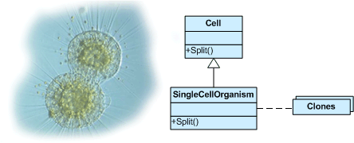
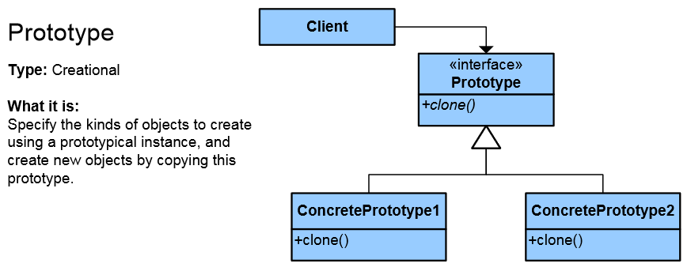
Prototype Pattern
Factory for cloning new instances from a prototype
Create new objects by copying this prototype
Instead of using "new" keyword
ICloneable interface acts as Prototype

Slide 30
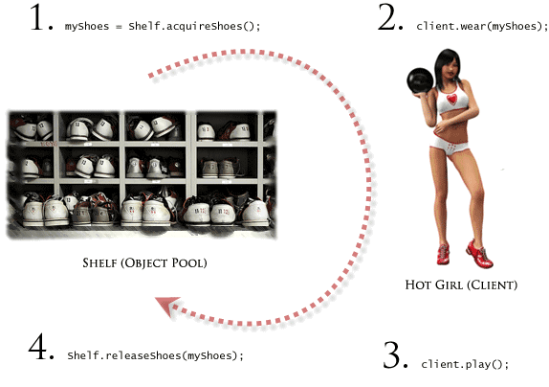

Other Creational Patterns
Object Pool
Avoid expensive acquisition and release of resources by recycling unused objects
Lazy initialization
Tactic of delaying the creation of an object, the calculation of a value, or some other expensive process until the first time it is needed

Slide 31
Design Patterns I
https://softuni.bg/courses/high-quality-code/

Slide 32

License
This course (slides, examples, demos, videos, homework, etc.) is licensed under the "Creative Commons Attribution-NonCommercial-ShareAlike 4.0 International" license
Attribution: this work may contain portions from
"High Quality Code" course by Telerik Academy under CC-BY-NC-SA license

Slide 33







SoftUni Diamond Partners

Slide 34





Free Trainings @ Software University
Software University Foundation – softuni.org
Software University – High-Quality Education, Profession and Job for Software Developers
softuni.bg
Software University @ Facebook
facebook.com/SoftwareUniversity
Software University @ YouTube
youtube.com/SoftwareUniversity
Software University Forums – forum.softuni.bg

